Slide 1

BEGINNER PROGRAMMING LESSON
Introduction to the EV3 Brick and Software

Slide 2
Lesson Objectives
Learn how the EV3 brick operates
Learn about the main components of the EV3 software

Slide 3
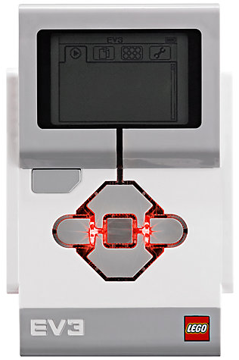
The “Brick” Buttons
1 = Back Undo Stop Program Turn robot off
2 = Center Button Select options Run Program Turn robot on
3 = L, R, Up, Down Navigate menus
1
3
3
2
3
3

Slide 4
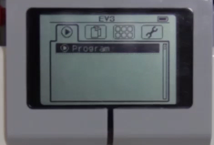
The “Brick” Screen
Tabs on Screen
Run Recent Find programs you ran recently
2. File Navigation Find all programs by project
3. Brick Apps Port views
4. Settings Bluetooth, Wifi, Volume
1
2
3
4

Slide 5
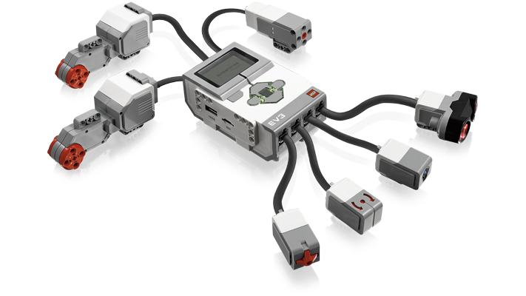
Ports, Sensors, motors
Ports A, B, C, D = Motors
Default setup assumes Right Motor in C, Left Motor in B
B
Default setup
Front
C
Ports 1, 2, 3, 4 = Sensors

Slide 6
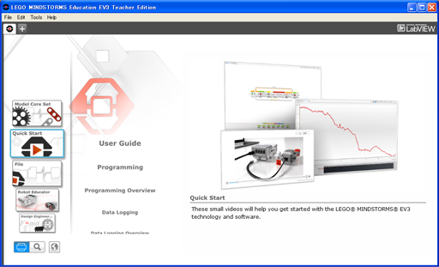
EV3 Software
Open Saved Project
Open New Project

Slide 7

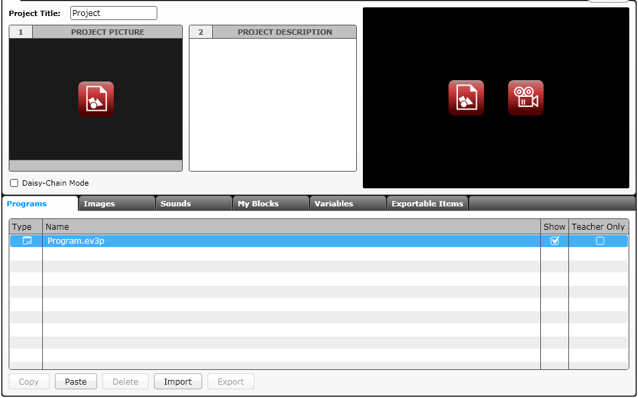
EV3 Software: Starting A new program
Create a Project
Opened Programs
Opened Projects
Create a Program
Project Properties
List of programs

Slide 8
PROJECTS VS. PROGRAMS
You will start by creating a PROJECT which has a .ev3 extension. You change the name of a project by using the Save Project As option from the File menu.
You will write many PROGRAMS as part of each PROJECT file. You change the name of a program within a project by doubling clicking on the program’s tab and typing in a new name.
Note: If there is an * next to the project name, you have made changes to the project and you have not yet saved yet.
There is a “x” next to project and program names. Clicking on it simply closes the file (it does not get deleted).
Here are some common file extensions in the EV3:
Programs (.ev3p)
Images (.rgf)
Sounds (.rsf)
Text (.rtf)
Projects (.ev3) – the only type of file you can open with the EV3 software
Import file (.ev3s) – can be imported by an EV3 project

Slide 9
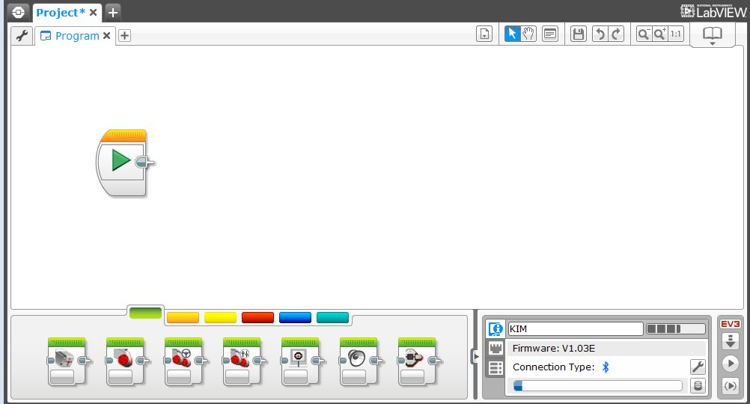
EV3 Software: Programming screen
Programming Area or Canvas
Programming Blocks in
6 Colored Tabs
Brick Status & Downloading

Slide 10
Useful Icons
1
2
3
4
5
6
7
List Programs in Project: List of all programs in the project
Select: The cursor looks like an arrow and you can pick specific blocks or areas of the screen
Pan: The cursor looks like a hand. When you click and move the mouse, you can move through the program when it goes beyond one screen.
Comments: Click on this icon to create the comment box
Save Project: Save the current version of your project
Undo and Redo: Undo or redo the last actions
Zoom Out, Zoom In, and Reset Zoom: Use to decrease, increase or reset the magnification

Slide 11
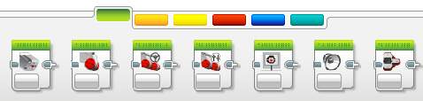
EV3 Blocks: Colored Tabs
ACTION BLOCKS
Move, Large & Medium Motor, Display…
FLOW BLOCKS
Start, Wait, Loop, Switch, Loop Interrupt
SENSOR BLOCKS
Brick Buttons, Gyro, Color, Ultrasonic
1
2
3
1
2
3
4
5
6
DATA OPERATIONS
Variables, Array, Logic, Math, Compare…
ADVANCED BLOCKS
Data Logging, Unregulated Motor…
MY BLOCKS
Custom Blocks you create
4
5
6

Slide 12
CREDITS
Author: Sanjay and Arvind Seshan
More lessons are available at www.ev3lessons.com
This work is licensed under a Creative Commons Attribution-NonCommercial-ShareAlike 4.0 International License.

